Slide 1


Slide 2
Management of advanced and recurrent endometrial cancer
Zohreh Yousefi / Fellowship of Gynecology Oncology
Ghaem Hospital, Mashhad University of Medical Sciences

Slide 3
The cornerstone of treatment for endometrial cancer is surgery
(Surgical Staging)

Slide 4
The surgery is as follows:
total or modified (type II) radical hysterectomy
bilateral salpingo-oophorectomy
peritoneal washings for cytologic study
pelvic lymphadenectomy to the aortic bifurcation
resection of grossly enlarged paraaortic nodes
omental biopsy
biopsy of any suspicious peritoneal nodules

Slide 5
MANAGEMENT OF STAGE II ENDOMETRIAL CARCINOMA
The surgery would include a
radical hysterectomy , (BSO)
salpingo- oophorectomy
lymph node dissection (LND) or sampling pelvic and para-aortic

Slide 6
Endometrial carcinoma spreads by the following routes:
Direct extension to adjacent structures
Trans-tubal passage of exfoliated cells
lymphatic dissemination
Hematogenous dissemination
lymphatic channels pass directly from the fundus to the paraaortic nodes through the infundibulopelvic ligament

Slide 7
The decision lymph node sampling surgeon dependent
prognostic features including
tumor size
tumor grade
depth of invasion
adnexal metastasis
cervical involvement
and positive cytologicy findings

Slide 8
Distribution of pelvic node metastases
in endometrial cancer
Common iliac
Superf.3/15 (20%)
Deep 1/15 (7%)
Presacral
1/15 (7%)
Obturator
Superf.11/15 (73%)
Deep 1/15 (7%)
External iliac
4/15 (27%)
Int J Gynecol Cancer, 1998

Slide 9
The contrast to cervical cancer, where paraaortic nodal metastases are always secondary to pelvic nodal metastases
It is quite common to find microscopic metastases in both pelvic and paraaortic nodes

Slide 10
Lymph-node Dissection
  All Grade 3
  Any > 50% myometrial invasion
  Any >2 cm tumor diameter
  All Serous/clear cell subtype
  Pre operative assessment of advanced disease (gross cervical or vaginal tumor)
Notes:
There is no contoversy that all Grade 3 regardless of depth of invasion
and all deeply invasive tumors regardless of grade, require complete surgical staging

Slide 11
Pelvic Lymphadenectomy
No preoperative scan is able to detect micrometastases in lymph nodes
If accurate surgical staging is to be obtained, full pelvic lymphadenectomy should be performed
on all patients who meet in the criteria
Sampling will only lead to inaccurate information

Slide 12
The dissection should include:
Removal of common iliac nodes
and of the fat pad overlying the distal
inferior vena cava
we noted that because of the patient's general medical condition full pelvic lymphadenectomy is
considered inadvisable

Slide 13
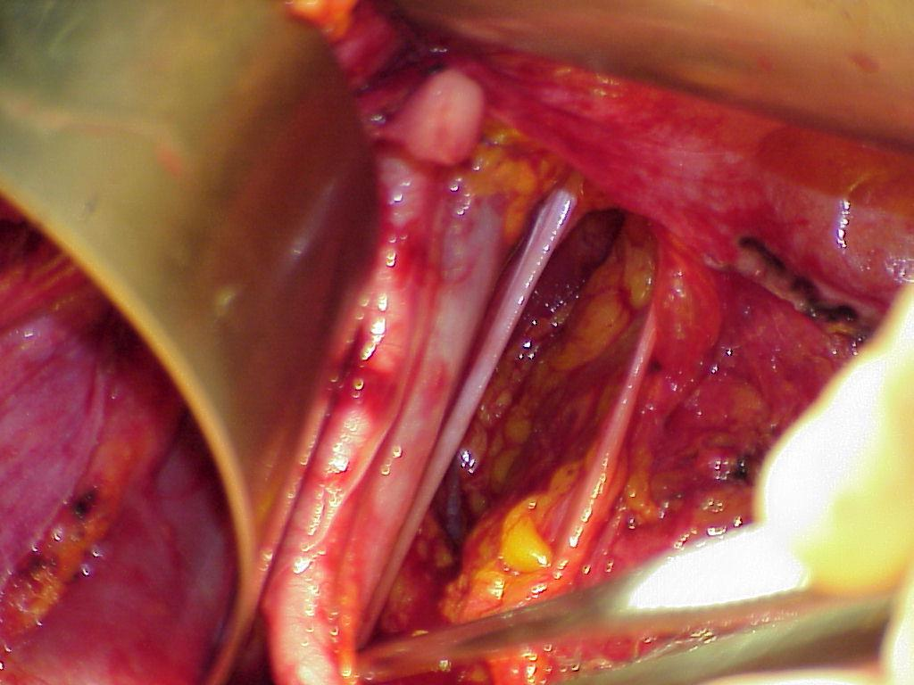
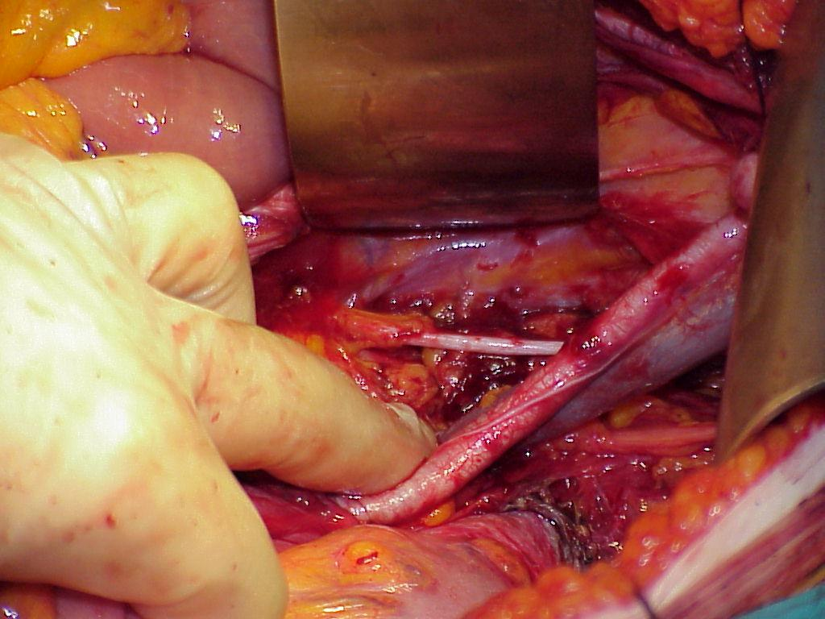
Lymph-node Dissection
Inaccurate LN palpation cannot substitute the histopathology report
Pre-operatory Grading and macroscopic judgement of depth of Myometrial Invasion are not sufficientely predictive of positive lymph nodes
62% of patients with positive pelvic nodes have metastatic para-aortic nodes
Arango et al, Obstet Gynecol 2000; Creasman et al, Cancer 1987

Slide 14
Distribution of aortic node metastases
in endometrial cancer
Intercavo-aortic
7/9 (78%)
Pre-caval
2/9 (22%)
Pre-aortic
2/9 (22%)
Para-caval
3/9 (33%)
Para-aortic
4/9 (44%)
Retro-caval
2/9 (22%)
Retro-aortic
Int J Gynecol Cancer, 1998

Slide 15
resection of any enlarged pelvic nodes should be performed
Can omit LN sampling if risk of lymph-node spread is low

Slide 16
The GOG data (63) suggested that patients with positive paraaortic nodes were likely to have:
grossly positive pelvic nodes
grossly positive adnexae
grade 2 or 3 lesions
outer-third myometrial invasion

Slide 17
high-grade cancers
papillary serous carcinoma
clear cell carcinoma
Uterine carcinosarcoma:
Squamous cell carcinoma
undifferentiated carcinomas
grade 3
All stages II-Iv

Slide 18
Treatment for high-grade cancers:
surgery may be more extensive
In addition to the TH/BSO
and the pelvic and para-aortic lymph node dissections (systematic pelvic lymphadenectomy)
at least removal of any clinically suspicious paraaortic lymph nodes
the omentum is often removed (5 × 5 cm)

Slide 19
Management of stage III and IV EC:
In all cases with no contraindication for surgery
primary treatment should start with surgery except
in stage IIIB or IVB disease

Slide 20
Special Clinical Circumstances

Slide 21
When both the cervix and the endometrium
are clinically involved with adenocarcinoma,
may be difficult to distinguish between a stage IB adenocarcinoma of the cervix and
stage II endometrial carcinoma.
Histopathologic evaluation is not helpful
in the differentiation

Slide 22
diagnosis must be based on
clinical and epidemiologic features.
The obese, elderly woman with a bulky uterus is more likely to have endometrial cancer
whereas the younger woman with a bulky cervix and a normal corpus is more likely to have cervical cancer

Slide 23
Endometrial Cancer Diagnosed after Hysterectomy
PET or CT scan of the chest , pelvis, and abdomen
a serum CA125 measurement
If all investigations are negative, then
approach is as follows
Grade 1 or 2 endometrioid lesions
less than one-half myometrial invasion:
no further treatment
although prophylactic oophorectomy is advisable

Slide 24
Systematic review of follow-up for
EC:(1980-2009) 16 studies:
Overall risk of recurrence was 13%
A 3% for low risk.
70% of recurrences were symptomatic.
68%to 100% of recurrences occurred within the first 3 years.
Detection of asymptomatic recurrences ranged from
33%with physical examination
0 to 4% with vaginal vault cytology
0 to 14% CXR
4 to 13%abdominal ultrasound
5 to 21%with abdominal/pelvic CT scan
15% with CA125
Gynecologic Oncology 101(2006)520 529.

Slide 25
Women with recurrences detected soon after treatment fared more poorly than women whose recurrences were detected later .
Patients with an isolated vaginal recurrence
have a higher chance of cure than those with
pelvic or abdominal recurrences,
who better than those with distant metastases.
Complete remission was 89% with vaginal relapse
3 yr survival 73% in contrast to
8% and 14% after
pelvic and distant relapse

Slide 26
Systemic treatment:
Hormone therapy
Chemotherapy
Target therapy

Slide 27
Hormone therapy:
Primary hormone therapy has been used for women with early-stage disease who wish to preserve fertility
for patients with advanced EC who are not eligible for curative surgical treatment
Or not eligible RT because of severe co-morbidity or
extended disease
Positive predictive factors for response are
expression of ER and /or PR
low grade histology
and a long treatment-free interval.

Slide 28
Progestin:
PR of progestin ranged from 18 to 34% in patients
with advanced or recurrent EC
Progestin include
Hydroxy progesterone caproate (RR:37%)
MPA (RR:9-53%)
MA (RR:24-46%).
Tamoxifen :
RR: 30-35%
TAM+MPA: RR:60%
TAM+MA: RR:19%
GnRH analogues: RR:35-12%
Aromatase inhibitors: Letrozole Anastrosole RR:9%.

Slide 29
In a meta-analysis of 6 trials
Progestin's as adjuvant treatment after curative treatment with surgery with or without RT
do not have a beneficial effect in 4351 patients with primarily stage I disease
no difference was observed in
reduction of relapse or death from EC.

Slide 30
Chemotherapy:
In EC, CT may be administered as
adjuvant therapy
primary systemic therapy
,neo-adjuvant therapy
induction therapy or as radio- sensitizer.
Single agent CT:
Doxurubicin ,cisplatin, carboplatin
,Ifosfamide ,Paclitaxel are effective
single agents in EC with
RR from 4% to 42% for non paclitaxel
and RR from 36% to 77% for paclitaxel
,which makes this drug the most active agent.

Slide 31
Combination CT:
Since 1984 CAP regimen has been evaluated
in advanced and recurrent EC and showed
RR:31%-60%.
After adding Paclitaxel
TAP is the most effective C-T (RR:57%).
Regarding the high toxicity of TAP (40%-73%),
the combination of Paclitaxel and Carboplatin
have been concentrated in phase II and III trials.

Slide 32
Radiotherapy:
RT can be administered locally, to the pelvis
or the whole abdomen.
meta-analysis
each 10% increase in patients receiving post-operative
RT improved survival by 11 months.
Some patients in whom surgery is contraindicated because of severe comorbidity,
as cardiopulmonary disease
and morbid obesity,
are clinically staged, curative RT is used.

Slide 33
Management of recurrent EC:
Represent patients with recurrent EC
a heterogeneous group with different
histological types
grades
Stage
disease free interval
prior surgical complete staging or incomplete staging
various sites of recurrence in or outside an irradiated area.

Slide 34
Management of recurrent EC according to the site of recurrence:
Local recurrence: is divided as recurrence in
a RT-naive area
and an irradiated area.
5-year survival rate
10-43% in patients with prior irradiated
vs. 65% without.

Slide 35
In irradiated area:
Surgical resection is the first choice.
Pelvic exenterating remains the only potentially curative option for the few patients with a local central recurrence involving bladder and/ or rectum.
In RT –naive area:
RT is the first choice.
A major determinant for local control is tumor size.

Slide 36
Regional recurrence:
For upper abdominal ,peritoneal recurrences or pelvic recurrences outside an irradiated area
systemic treatment with or RT and surgery recommended.
Surgical resection is the best option for patient with a recurrence within a previously irradiated field.
The most important prognostic factor associated with survival is the amount of residual disease.

Slide 37
Salvage cytoreductive surgery for recurrent EC:
35 patients with recurrent EC underwent cytoreductive surgery.
Median survival was 39 months in patients with complete cytoreduction compared to
13.5 month for patients with gross residual disease.
Gynecologic oncology 2006 vol 103

Slide 38
Distant recurrences:
Systemic treatment is indicated for most patient with distant recurrent disease.
Surgical treatment might be the treatment of choice for
an isolated metastases.
RT can be administered to an isolated metastasis that
cannot be resected or to symptomatic metastases.
The main indications for palliative RT are not only
pelvic disease causing VB but
also symptomatic brain and painful bone metastases.

Slide 39


